Slide 2
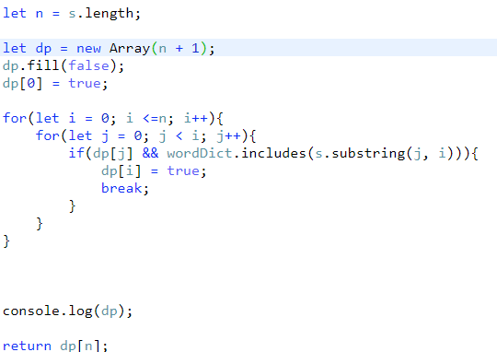
i
j
s =
‘’ | P | E | A | N | U | T | B | U | T | T | E | R
0 | 1 | 2 | 3 | 4 | 5 | 6 | 7 | 8 | 9 | 10 | 11 | 12
T | F | F | F | F | F | F | F | F | F | F | F | F
2 < 2 : false
‘pe’ in wordDict : false
dp[1] = false
wordDict = [‘pea’, ‘peanut’, ‘butter’]

Slide 3
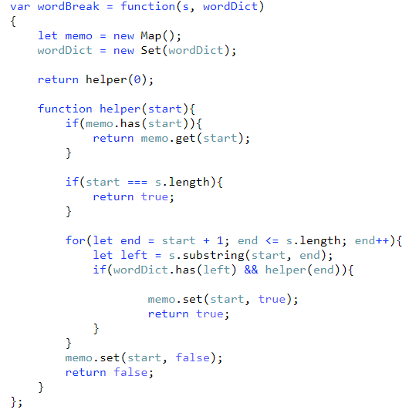
P | E | A | N | U | T | B | U | T | T | E | R
0 | 1 | 2 | 3 | 4 | 5 | 6 | 7 | 8 | 9 | 10 | 11
F | F | F | F | F | F | F | F | F | F | F | F
wordDict = [‘pea’, ‘peanut’, ‘butter’]
s = peanutbutter
s.len = 12
start = 0
end = 3
left = pea

Slide 4
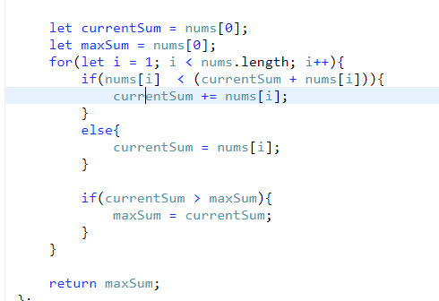

Slide 5
A
B
C
D
E
F

Slide 6
A
B
C
D
E
F

